Slide 1
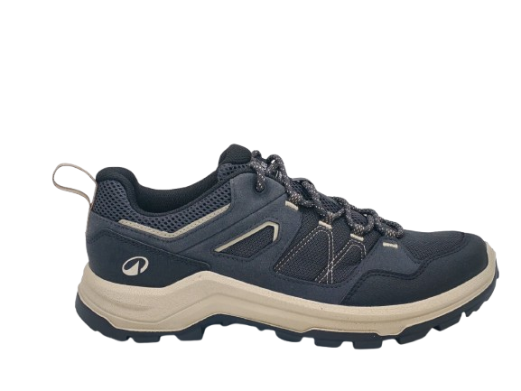
MH100 Carbon grey beige (9026135)

Slide 2
Country wise CDD :
EU (WK- 5)
CANADA (WK- 5)
BRAZIL (WK- 6)
LATAM (WK- 7)
CHINA (WK- 1)
1st Hand over WK-51
1st Week Need 16270 pairs
Supplier wise bulk ETA
Wanhua- wk 37
Hanyoung- wk 37
Formosa - wk 40
Daesung - wk 40
Lienchau WK-40
Dragon Up-wk 41 (Available)
Furong-wk 41
Longxiang - wk 41
Rhenoflex-wk41
 | PROJECT LAUNCH | BOM VALIDATION | Bulk Booking | FSR VALIDATION | MASS CPT INHOUSE | GO INDUS | GO PROD | GO SHIP | CDD
RETRO | WK 36, 2025 | WK 26 | WK 26 | WK 29 | WK 40 | WK 41-43 | WK 44 | WK 48 | WK 5
EXPECTATION | WK 36, 2025 | WK 28 | WK 29 | WK 28 | WK 41 | WK (38-42) | WK 42 | WK 48 | WK 5

